Slide 1
Health Sphere
PIP104 PROFESSIONAL PRACTICE-II
VIVA-VOCE
Batch Number:
Roll Number | Student Name
20201COM0044 | Pratyush Kumar Rai
20201COM0052 | Mazahir K Najmi
20191COM0222 | Vyravel
Under the Supervision of,
Dr.Pallavi M
Assistant Professor
School of Computer Engineering
Presidency University

Slide 2
Introduction
Healthcare Landscape Transformation: The convergence of advanced technology and a renewed patient-centric approach is poised to revolutionize healthcare.
Challenges in Traditional Healthcare: Limitations in patient engagement, immediate access to medical information, and personalized support hinder a seamless healthcare experience.
Pioneering Hospital Management Application: A transformative solution is introduced to redefine hospital operations, integrating an AI-driven chatbot.
AI-driven Chatbot's Purpose: Prioritizes patient engagement and empowerment by offering a comprehensive repository of medical knowledge.
Versatile Support: Addresses a wide range of health-related queries, from symptoms and treatments to medication concerns and general healthcare inquiries.
Real-time, Reliable Information: Provides accurate and timely information, empowering patients to make informed decisions about their health journey.

Slide 3
Literature Review
Name | Authors | Link
Mr. Doc: A Doctor Appointment Application System | Shafaq Malik Nargis Bibi Sehrish Khan Razia Sultana | https://arxiv.org/abs/1701.08786
Design and Implementation of a Patient Appointment and Scheduling System | Akinode,John Lekan Oloruntoba S.A | https://www.researchgate.net/profile/Akinode-John-Lekan/publication/332864696_Design_and_Implementation_of_a_Patient_Appointment_and_Scheduling_System/links/5ccdf7c2a6fdccc9dd8d4628/Design-and-Implementation-of-a-Patient-Appointment-and-Scheduling-System.pdf
mHealth: Blood donation application using android smartphone | Muhammad Fahim Halil Ibrahim Cebe Jawad Rasheed Farzad Kiani | https://ieeexplore.ieee.org/abstract/document/7543997
THE DEVELOPMENT OF A COMPUTER-BASED STAFF MANAGEMENT SYSTEM | Engr. Mosud Y. Olumoye | https://www.eijst.org.uk/images/frontImages/gallery/Vol._2_No._9/5.pdf

Slide 4
Research Gaps Identified
Hospital Management Application Innovation: Introduces an AI-driven chatbot to redefine hospital operations and enhance patient support.
Comprehensive Medical Query Solution: The AI chatbot provides comprehensive answers to various medical queries, from symptoms to treatments and medication inquiries.
Prioritizing Patient Empowerment: Designed to prioritize patient empowerment, fostering a deeper understanding of health concerns and facilitating informed decision-making.
Real-time Access to Vital Information: Offers real-time access to crucial medical information, enabling proactive healthcare management and confident navigation of the healthcare journey.
Seamless Integration and Complementary Functionality: Seamlessly integrated into the app's interface, complementing existing functionalities to empower patients with confidence and clarity.

Slide 5
Proposed Methodology
User-Centric Analysis: Conduct user-centric analysis through surveys, interviews, or usability testing to gauge user perceptions, preferences, and experiences with the AI chatbot. This phase aims to understand user needs, expectations, and challenges in engaging with the application.
Functionality Assessment: Evaluate the functionality and performance of the AI chatbot. Assess its responsiveness, accuracy in providing medical information, ability to address diverse queries, and integration within the application's interface.
Impact Evaluation: Measure the impact of the AI chatbot on patient empowerment, decision-making, and engagement. Use qualitative and quantitative metrics to assess improvements in healthcare literacy, patient satisfaction, and informed decision-making processes.
Medical Accuracy Verification: Validate the medical accuracy and reliability of information provided by the AI chatbot. Collaborate with healthcare professionals to verify the correctness and alignment of responses with established medical guidelines and standards.

Slide 6
Proposed Methodology
Privacy and Security Audit: Conduct a comprehensive audit to ensure robust data privacy and security measures within the application. Verify compliance with healthcare regulations (such as HIPAA) and assess data encryption, user data handling, and consent mechanisms.
Integration Challenges Analysis: Investigate technical challenges and integration issues faced during the implementation of the AI chatbot. Document and address obstacles encountered in integrating the chatbot seamlessly into the hospital management application.
Iterative Improvement Plan: Develop an iterative improvement plan based on findings. Implement refinements to enhance the chatbot's functionality, usability, and medical accuracy. This step ensures continuous enhancement of the application based on user feedback and evolving healthcare needs.

Slide 7
Objectives
User Engagement Assessment: Evaluate user engagement levels and patterns with the AI chatbot to understand the frequency of interactions, types of queries, and user satisfaction.
Usability and User Experience Analysis: Assess the ease of use and overall user experience by analyzing user feedback, navigation patterns, and the chatbot's interface design.
Impact on Patient Empowerment: Measure the impact of the AI chatbot on patient empowerment, including improvements in healthcare literacy, informed decision-making, and self-management of health concerns.

Slide 8
Objectives
Functionality and Performance Evaluation: Evaluate the AI chatbot's performance in providing accurate and relevant medical information, responsiveness, and its ability to handle diverse medical queries effectively.
Medical Accuracy Validation: Verify the medical accuracy and reliability of information provided by the AI chatbot by collaborating with healthcare professionals for validation and alignment with medical guidelines.
Privacy and Data Security Assurance: Ensure robust data privacy and security measures within the application, including compliance with healthcare regulations and safeguards for user data handling.
Identification of Integration Challenges: Identify technical challenges and integration issues encountered during the chatbot's implementation within the hospital management application.

Slide 9
System Design & Implementation
Modular Design: The architecture is divided into two main modules: "Frontend App" and "Backend Services". This modular approach facilitates easier maintenance and scalability.
User Interaction: There are three types of users interacting with the system - general users, admins, and doctors. Each has a defined pathway to interact with the frontend application.
Frontend Application: The app is developed using Flutter, indicating cross-platform compatibility. The Flutter App interfaces with all types of users, providing a unified user experience.

Slide 10
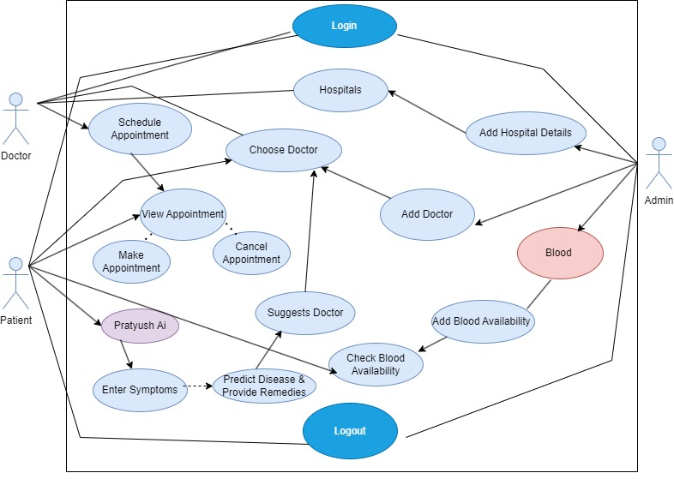
System Design & Implementation

Slide 11
Timeline of Project
The project commenced on October 3, 2023.
The phase of "Research and Analysis" spanned from October 3, 2023, to October 26, 2023, lasting approximately three weeks.
Following the research phase, the "Requirements Collection" phase initiated on October 27, 2023, and concluded on October 30, 2023, lasting only a few days.
The "Design" phase, which appears to be the most extensive phase, started on October 30, 2023, and extended until November 26, 2023, taking nearly four weeks.
A "Review" phase is scheduled post-Design, beginning on November 28, 2023, and ending on December 19, 2023, lasting about three weeks.

Slide 12
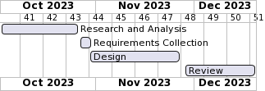
Timeline of Project

Slide 13
Outcomes / Results Obtained
More allowing users to access the programme, system testing must be conducted after the system is been successfully implemented to identify any errors. Before allowing users to use the system, few different sorts of testing will be carried out to ensure that it is error-free. Functional testing, unit testing, and integration testing are the different types of testing. Prior to integration into the application, all of these tests need to be properly examined.

Slide 14
Conclusion
Enhanced Patient Engagement: The AI chatbot significantly enhances patient engagement by providing immediate and comprehensive responses to a wide array of medical queries, fostering a deeper understanding of health-related concerns.
Improved User Experience: User-centric design and seamless integration of the chatbot within the application elevate the user experience, empowering patients to navigate their healthcare journey with confidence and clarity.
Impact on Healthcare Literacy: The chatbot contributes to improved healthcare literacy, enabling informed decision-making among patients by providing timely and reliable information on symptoms, treatments, and general healthcare inquiries.
Challenges and Considerations: However, challenges such as ensuring medical accuracy, addressing privacy concerns, and overcoming integration hurdles underscore the need for ongoing refinement and vigilance in deploying AI-driven solutions in healthcare settings.

Slide 15
References
Zhiqiang Hu, Lei Wang, Yihuai Lan, Wanyu Xu, Ee-Peng Lim, Lidong Bing, Xing Xu, Soujanya Poria, Roy Ka-Wei Lee. LLM-Adapters: An Adapter Family for Parameter-Efficient Fine-Tuning of Large Language Models, arXiv:2304.01933, 2023.
Baig, M.M., GholamHosseini, H. & Connolly, M.J. Mobile healthcare applications: system design review, critical issues and challenges. Australas Phys Eng Sci Med 38, 23–38 (2015). https://doi.org/10.1007/s13246-014-0315-4002E
Albert Q. Jiang, Alexandre Sablayrolles, Arthur Mensch, Chris Bamford, Devendra Singh Chaplot, Diego de las Casas, Florian Bressand, Gianna Lengyel, Guillaume Lample, Lucile Saulnier, Lélio Renard Lavaud, Marie-Anne Lachaux, Pierre Stock, Teven Le Scao, Thibaut Lavril, Thomas Wang, Timothée Lacroix, William El Sayed. Mistral 7B, arXiv:2310.06825, 2022.

Slide 16
References
Jiaqi Wang, Zhengliang Liu, Lin Zhao, Zihao Wu, Chong Ma, Sigang Yu, Haixing Dai, Qiushi Yang, Yiheng Liu, Songyao Zhang, Enze Shi, Yi Pan, Tuo Zhang, Dajiang Zhu, Xiang Li, Xi Jiang, Bao Ge, Yixuan Yuan, Dinggang Shen, Tianming Liu, Shu Zhang,Review of Large Vision Models and Visual Prompt Engineering, Meta-Radiology, 2023, 100047, ISSN 2950-1628, https://doi.org/10.1016/j.metrad.2023.100047.
Edward J. Hu, Yelong Shen, Phillip Wallis, Zeyuan Allen-Zhu, Yuanzhi Li, Shean Wang, Lu Wang, Weizhu ChenLoRA: Low-Rank Adaptation of Large Language Models. arXiv:2106.09685, 2021.
Simon Lermen, Charlie Rogers-Smith, Jeffrey Ladish. LoRA Fine-tuning Efficiently Undoes Safety Training in Llama 2-Chat 70B, arXiv:2310.20624, 2023.

Slide 17
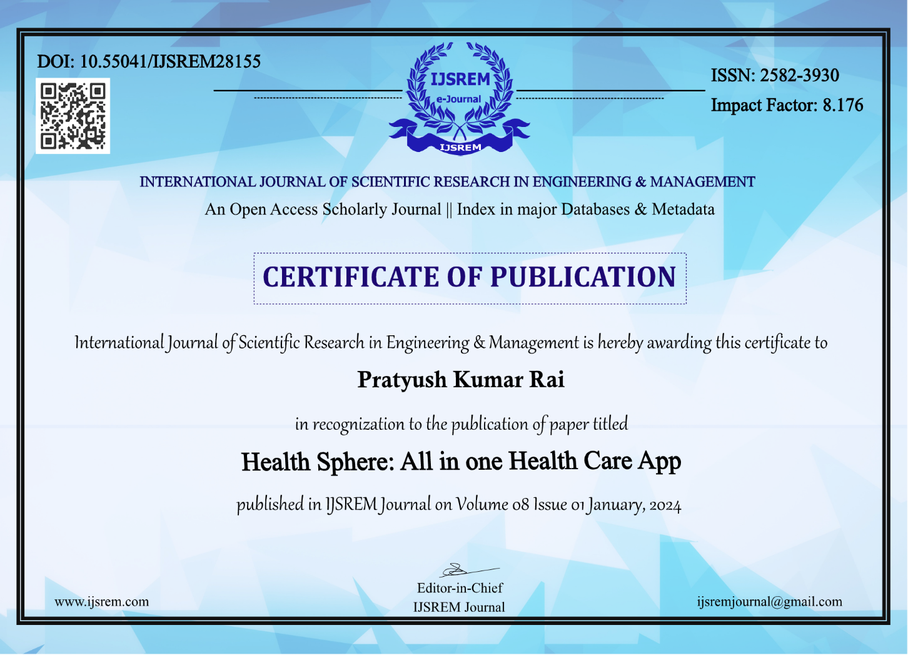

Publication Details

Slide 18
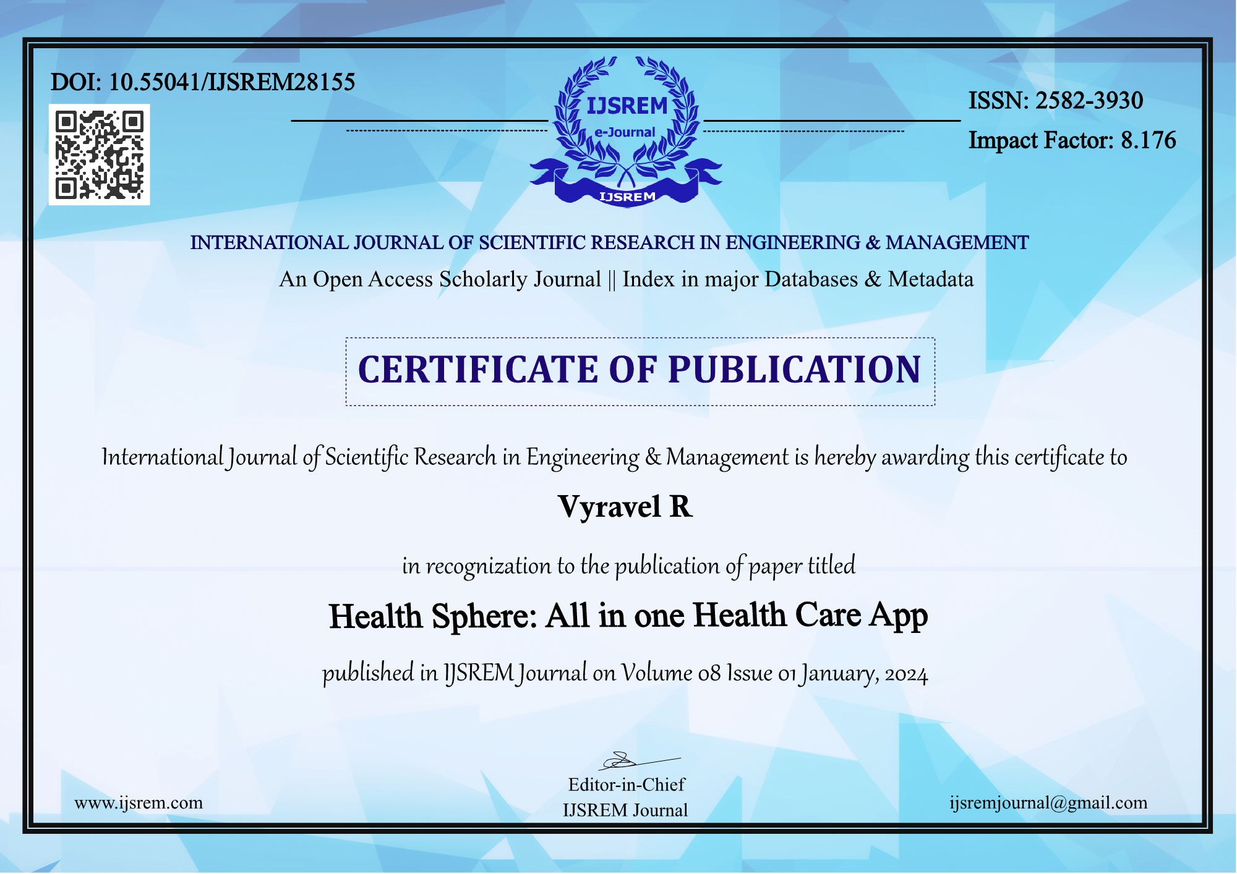

Slide 19
Achievements (if any)

Slide 20

Thank You

